Slide 1
Basics of FPGA
-Shantanu Shinde
-Aditya D’souza
-Gavin Lewis

Slide 2
Introduction
FPGA is an abbreviation for Field Programmable Gate Arrays.
In essence, FPGAs enable designers to program customized digital logic in the field.
The functioning of an FPGA can be defined after its manufacturing.
Thus, FPGAs allows one to adapt to new requirements and standards and reconfigure hardware for specific applications even after the product has been installed in the field-hence the term field programmable.
Gate arrays are two-dimensional arrays of logic gates.

Slide 3
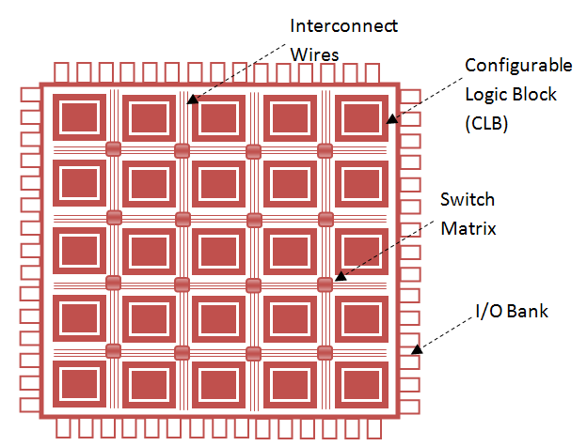
FPGA Architecture
The FPGA architecture consists of the following:
Configurable Logic Block(CLB)
Input / Output Block
Programmable Interconnects

Slide 4
Configurable Logic Blocks(CLBs)
A configurable logic block is a basic repeating logic resource on an FPGA. When CLBs are linked together by routing resources, the components in CLBs execute complex logic functions, memory functions and synchronize code on the FPGA.
Each CLB is further consists of slices which are further divided into logic elements.
Logic element consists of:
D flip-flop
Look-up Table(LUT)
Multiplexer

Slide 5
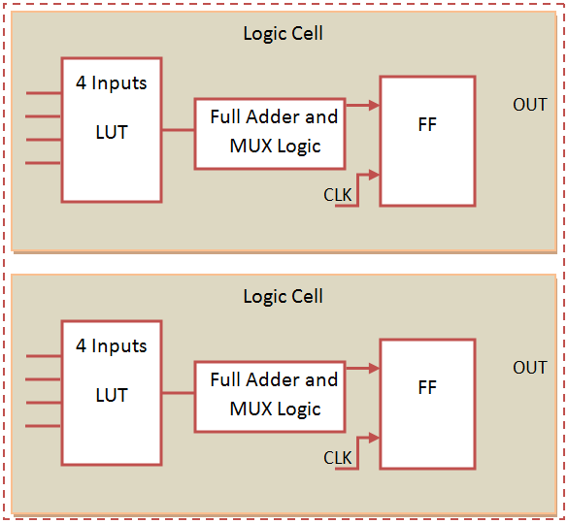
Configurable Logic Blocks (contd…)
The adjacent figure illustrates a two slice CLB.
Look-Up Table: It essentially stores the output for every possible combination of inputs.
Multiplexer: It is used for selection logic.
Flip-Flop: It stores the output of the LUT.

Slide 6

Look-Up Table(LUT)
Suppose we have a 2-input LUT. The possible combinations of inputs will thus be $2^{2}$=4.
The output for each set of inputs, naturally, depends upon the function defined.
Example
A | B | F
0 | 0 | 1
0 | 1 | 0
1 | 0 | 1
1 | 1 | 0
The adjacent figure depicts a function F defined randomly.
What happens here is that the inputs A and B, essentially, act as a pointer to the corresponding output.
This output maybe passed to another CLB or stored in a flip-flop or combine with a other input to the Multiplexer.

Slide 7
I/O Block
I/O block used to bring signals onto the chip and send them back off again.
It consists of an input buffer and an output buffer with three-state and open collector output controls.
An open collector ground is a type of output control which behaves like a switch being disconnected or connected to the ground.
The polarity of the output can usually be programmed for active high or active low output.

Slide 8
Programmable Interconnect
Connection lines are pre-laid vertically and horizontally on the circuit board.
Programmable switches are used to connect these lines to the various input / output of logic blocks.
These switching matrices are a set of multiplexers- where an incoming line can be connected to an outgoing line.
These switching matrices are present next to each and every CLB.
Xilinx FPGAs use SRAM (Pass Transistor) method to implement the above.

Slide 9
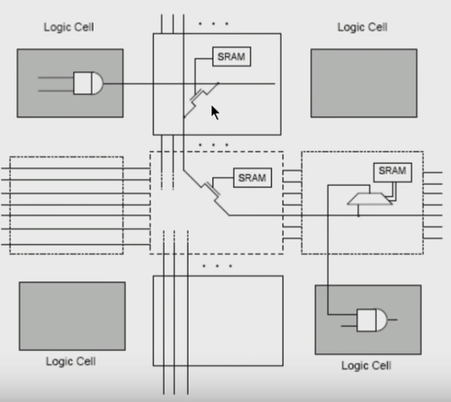
Programmable Interconnect (contd…)
The adjacent figure depicts the SRAM technique applied for routing purposes.
Initially, the SRAM stores the status of the connection between the lines.
Generally, 1 indicates connected and 0 indicates disconnected.
This value is provided to the transistors (pointed to by the cursor) and accordingly a connection is made or broken.
Transistors used are generally MOSFETs

Slide 10
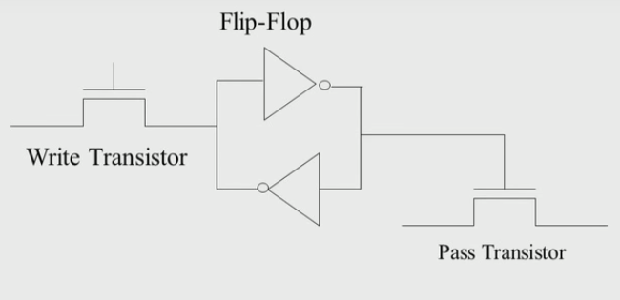
Programmable Interconnect (contd…)
The SRAM based technique employs a total of 6 transistors to implement the Programmable Interconnect.
Basically, the pass transistor passes a value which is opposite to the status we require.
The flip-flops then latch if we pass 0 and value 1 is stored in the write transistor.
It employs 4 transistors for the flip-flop, 1 each for the pass and write transistors.
This takes up a lot of space and introduces delays in propagation of signals.
Pass Transistor with configuration cell

Slide 11
Additional Components
Apart from the previously described components, the latest FPGAs have dedicated multipliers and DSP(Digital Signal Processing) slices.
Multipliers are included as the multiplication operation is highly resource intensive if implemented using combinatorial logic.
DSP slices are mainly used for the multiply-accumulate(MAC) operation which is very common in DSP.
MAC operation is basically calculating the product of two numbers and adding that to the accumulator.
Block RAM is another component found in the latest FPGAs that is user defined.
It is useful to pass data between parallel task and for storing the data sets.

Slide 12
Implementing programs on an FPGA
An FPGA contains a large number of CLBs, Programmable interconnects, etc.
However, one does not need to configure all of these components at such a basic level.
One simply uses a HDL like Verilog or VHDL to define their logic and even run simulations on the software itself.
Initially the RTL description in VHDL or Verilog is simulated by creating test benches to simulate the system and observe results.
Then, after the synthesis engine has mapped the design to a netlist, the netlist is translated to a gate-level description where simulation is repeated to confirm the synthesis proceeded without errors.
A netlist is basically the list of electronic components and how they are connected.
This program file is then compiled into a bitstream file by using the design tool.
This bitstream file is then loaded onto the FPGA, generally, via a micro-USB cable with the help of a software on an EEPROM on the FPGA.

Slide 13
Miscellaneous
If a large number of LUTs are not being used for logic implementation, they maybe used as RAM using the LUT RAM write control circuit.
Since these LUTs are spread across various CLBs, they are referred to as distributed RAMs.
Access latency can vary for the above.

